Slide 1

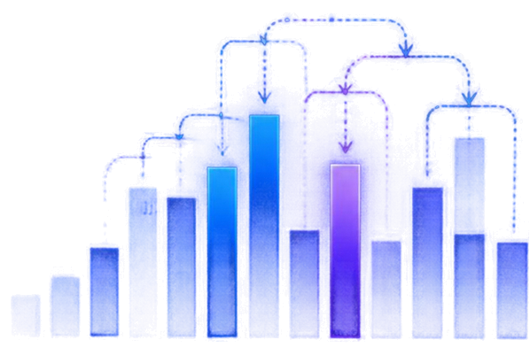

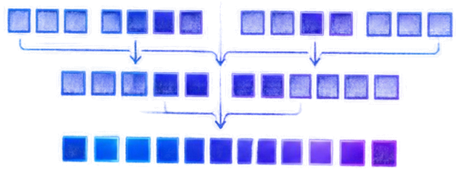
Sorting and
Searching
Algorithm Visualizer
Visualizing Algorithms Through
Interactive Step-by-Step Execution
TEAM
AlgoVista
TEAM MEMBERS
M.NAVYA SRI,B.SRIJA,D.NAVYA,J.BHAVYA
HACKATHON
HackForward 2026
DATE
October 3, 2026
TECHNOLOGIES
HTML, CSS, JavaScript

Slide 2




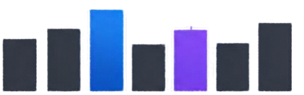









Problem Statement
TRADITIONAL APPROACH
OUR VISUALIZER
Input
Step 1: Compare
Traditional programs show only
the final result, hiding how
decisions are made.
8 3 7 1 4
Step 2: Swap
Our visualizer reveals every step
with comparisons, progress, and timing.
Final Output
1 3 4 7 8
Step n: Sorted
Making algorithms
clear, interactive, and intuitive.

Slide 3














Objectives
What our visualizer is designed to achieve
Visualize key
DAA algorithms
Show every comparison
and decision
Count steps
and comparisons
Measure
execution time
Compare
algorithm
behavior
Deliver an engaging learning experience

Slide 4








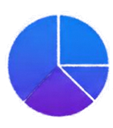









Proposed Solution
A seamless workflow that turns complex algorithms into clear, interactive insights.
01
02
03
04
05
06
USER INPUT
ALGORITHM SELECTION
EXECUTION
VISUALIZATION
STATISTICS
RESULT
Enter or generate your dataset to
get started.
Choose the sorting or searching algorithm.
Run the algorithm step by step
or at any speed.
Watch the process unfold with live visual feedback.
View performance metrics and comparisons.
See the final output with complete clarity.

Slide 5
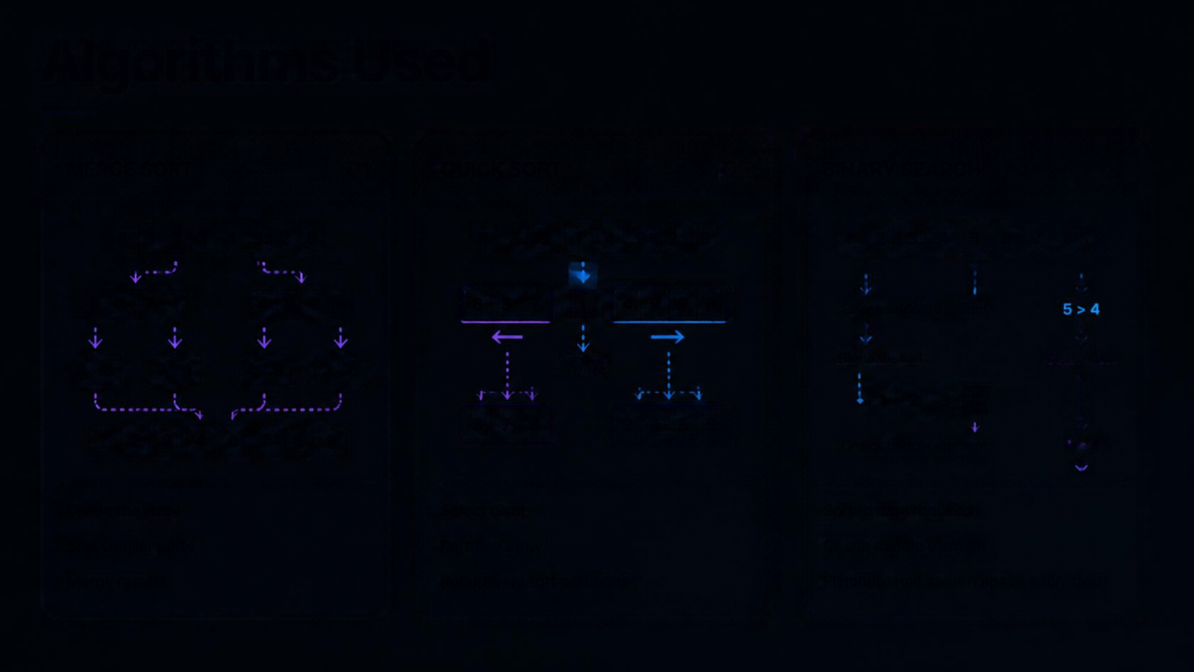























Algorithms Used
MERGE SORT
01
QUICK SORT
02
BINARY SEARCH
03
83714926
83714926
123456789
8371
4926
837
1
4926
Check middle element
83
71
4926
26
PIVOT
Eliminate half
Search left
1234
378
2469
123456789
Check middle element
4=4
Divide the array
Select pivot
Sorted data required
Sort smaller parts
Partition array
Check middle element
Merge results
Recursively sort partitions
Eliminate half search space each step

Slide 6




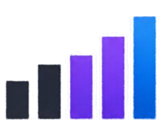








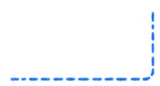





Technologies and Features
USER INTERFACE
ALGORITHM ENGINE
VISUALIZATION
HTML / CSS
JavaScript
& STATISTICS
TECHNOLOGIES
HTML — Structure
CSS — UI and animations
JavaScript — Algorithms and visualization engine
Merge Sort
Quick Sort
Binary Search
Steps
FEATURES
Comparisons
Interactive input and random arrays
Time (ms)
Visualizations for Merge Sort, Quick Sort, Binary Search
Step and comparison counters
Execution time measurement
Start / Pause / Reset controls
Responsive interface

Slide 7




Conclusion & Future Scope
Thank You
Interactive visuals that make
algorithms easy to understand
Step-by-step insights with
comparisons, progress, and timings
Expanding with more algorithms, complexity views, and performance tools
Built for learners, educators,
and curious minds

